Slide 1
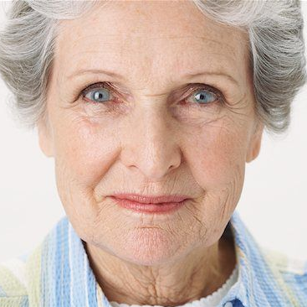
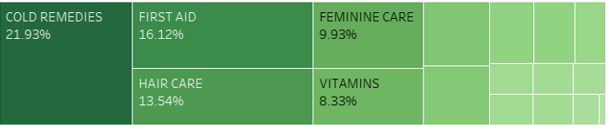
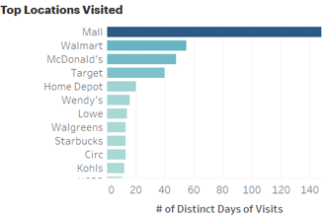
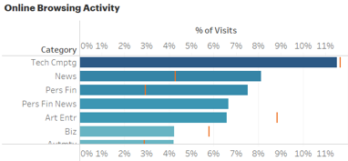


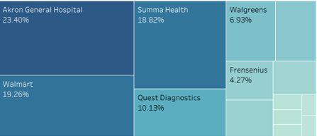












Bio
Susan is a 65-year-old retired college professor. She was born and raised in the Midwest. She grew up in a small town in near Detroit Michigan and was the oldest of five children. Her parents worked in the ford factory in Detroit who instilled in their children the importance of education and a strong work ethic.
After graduating from high school, Susan attended a local community college and earned her degree in English literature. She then went on to graduate in English literature from University of Michigan Ann Arbor with major in creative writing. She taught for 20 years in University of Michigan and then Case Western Reserve University in Cleveland till her retirement.
Susan had been married to her husband, Harry, for 37 years but lost him to cancer 5 years ago. They have three grown children and seven grandchildren. In her free time, Susan enjoys writing short stories, reading, gardening, and spending time with her grand children Susan is an active member of her community and works with the democratic party. She also volunteers for a homeless shelter. She is a diabetes patient for the last 15 years.
Motivations 1. Maintain healthy lifestyle
2. Maintain Financial independence
3. Give back to the community
4. Social influence as a democratic volunteer
5. Intellectual stimulus
SUSAN
Target persona for a new diabetes medication by a top US Pharmacy chain
“Not all those who wander are lost.”
Top medication categories by spend:
Top apps used on smartphones:
Visit behaviour to locations and medical stores:
Website Categories Visited:
Demography and Geography Age: 65 Education: Post grad in English Literature Work: Retired college professor Marital status: Widow Location: Akron Ohio USA Hobbies: Writing short stories
Psychographic details
Personality:
Deep family values
Independent & self sufficient
Warm & Hospitable
Loves to Socialize
Interests:
Reading English Literature
Writing short stories
Outdoors & gardening
Home cooking and new recipes
Lifestyle:
Health conscious & active life
Recycling and sustainability
Weekend book clubs
Community volunteering and awareness
Goals-
Pursue hobbies and interests
Spend time with family and friends
Travel to new locations
Stay active and healthy
Volunteering or community service
Financial planning
Publish books
Frustrations:
Difficulty in adapting to changing technologies
Health problems and complications arising from diabetes
Financial concerns since retirement
Increasing distances from immediate family
Familiar brands and small businesses getting closed
Increasing unemployment due to automation
Influencers and brands
Marketing channels
Email : Susan regularly checks her emails and has been a regular user due to her long career as an academic and current work as a volunteer for democratic party and the community in general
Direct mail: Susan is from the direct mail generation and uses the same for getting magazines, coupons and marketing offers in local chains
Social Media: Susan has started using Facebook to remain connected with her grandchildren who live across the country and also uses twitter to follow her favourite authors and politicians.

